Slide 1

Introduction to AI
Bootcamp by YouBee.ai

Slide 2

Table of Contents
What is AI
History of AI
Why did AI boom
Definition of Machine Learning
Applications of AI
Why do we use Python?
Bootcamp Roadmap

Slide 3
What is AI?
Programs that behave externally like humans?
Programs that operate internally as humans do?
Computational systems that behave intelligently?
Rational behavior?
Making computers that think?
The automation of activities we associate with human thinking, like decision making, learning ...?
The art of creating machines that perform functions that require intelligence when performed by people?
The study of computations that make it possible to perceive, reason, and act?
Anything in Computing Science that we don't yet know how to do properly?

Slide 4
Definition
AI is concerned mainly with rational action. The field of artificial intelligence, is concerned with not just understanding but also building intelligent entities—machines that can compute how to act effectively and safely in a wide variety of novel situations.

Slide 5
Turing Machine
The Turing test, proposed by Alan Turing (1950), was designed as a thought experiment that would sidestep the philosophical vagueness of the question “Can a machine think?”
Natural language processing to communicate successfully in a human language
knowledge representation to store what it knows or hears
automated reasoning to answer questions and to draw new conclusions;
machine learning to adapt to new circumstances and to detect and extrapolate patterns.
Later Total Turing machine added these :
computer vision and speech recognition to perceive the world;
robotics to manipulate objects and move about.

Slide 6
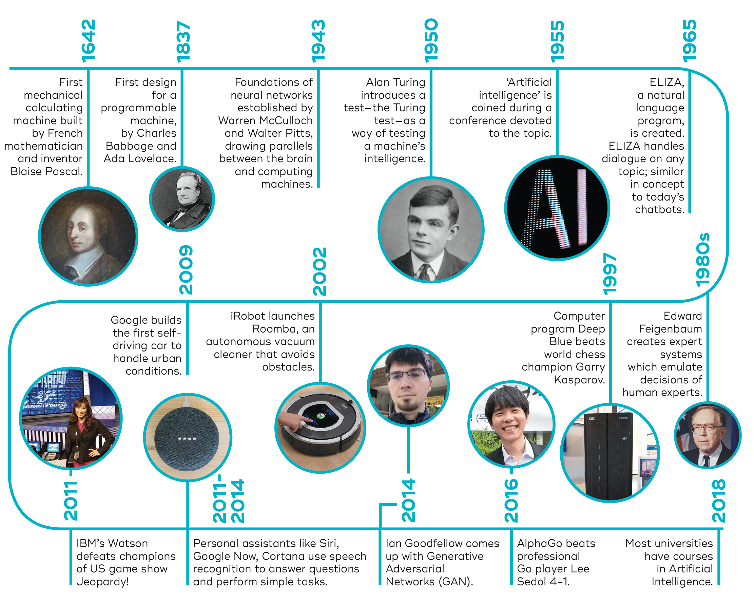
AI History

Slide 7
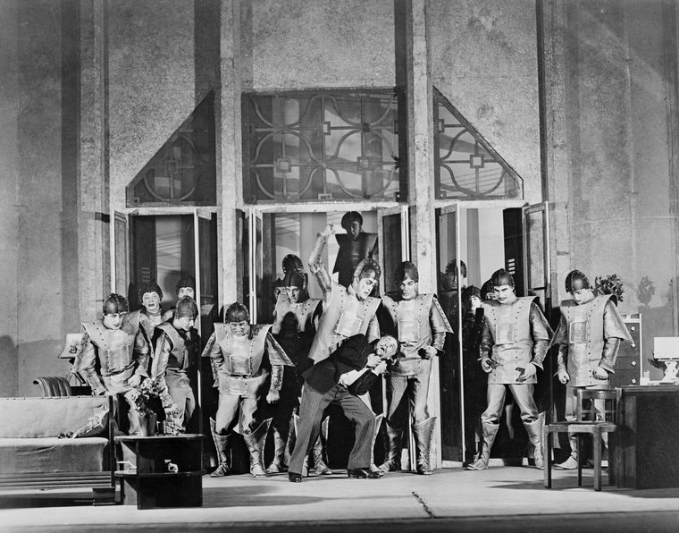
1921

Slide 8
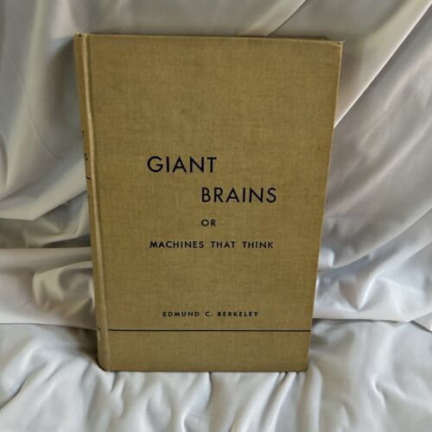
1949

Slide 9
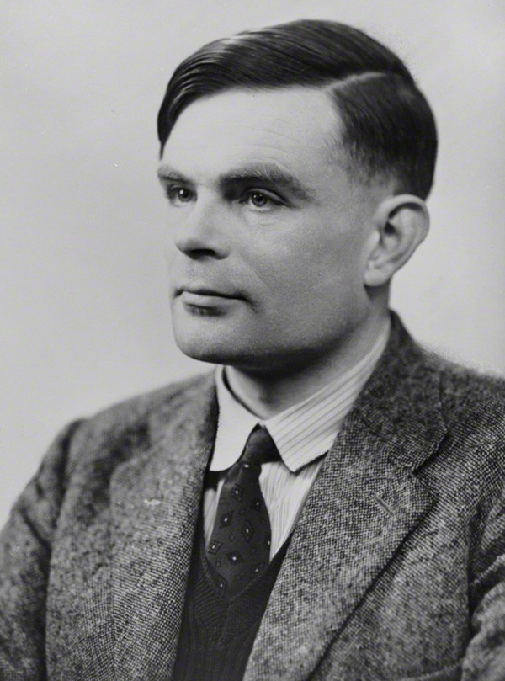
1950

Slide 10
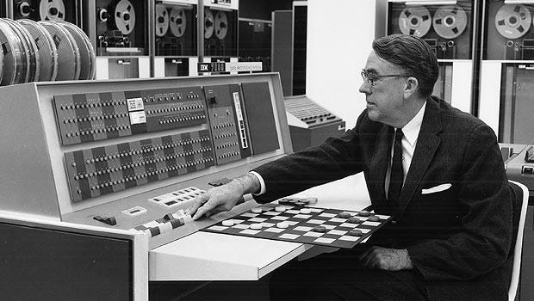
1952

Slide 11
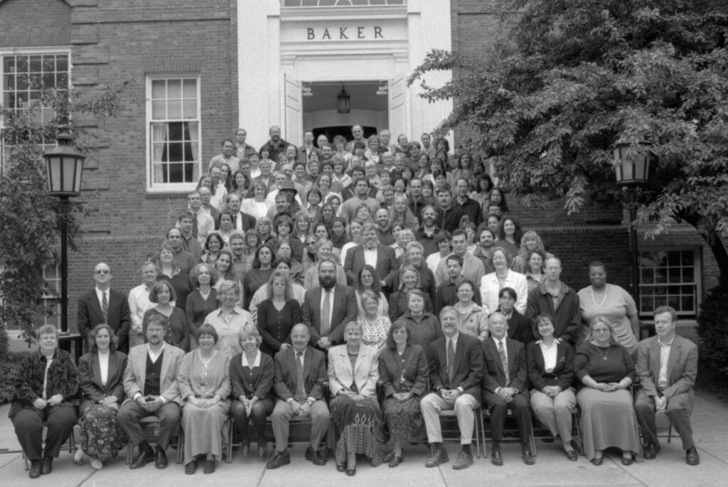
1956

Slide 12
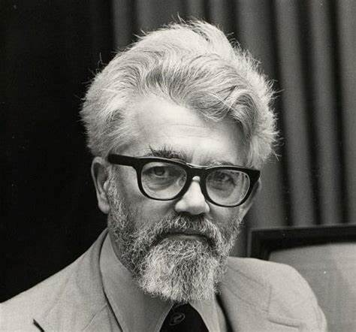
1958

Slide 13

1961

Slide 14
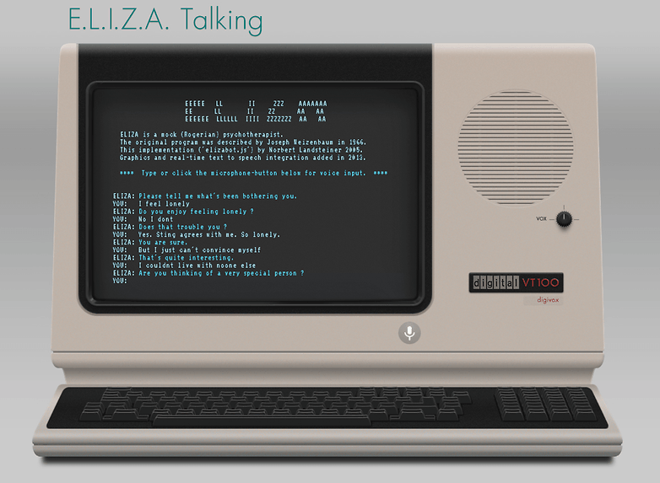
1966

Slide 15
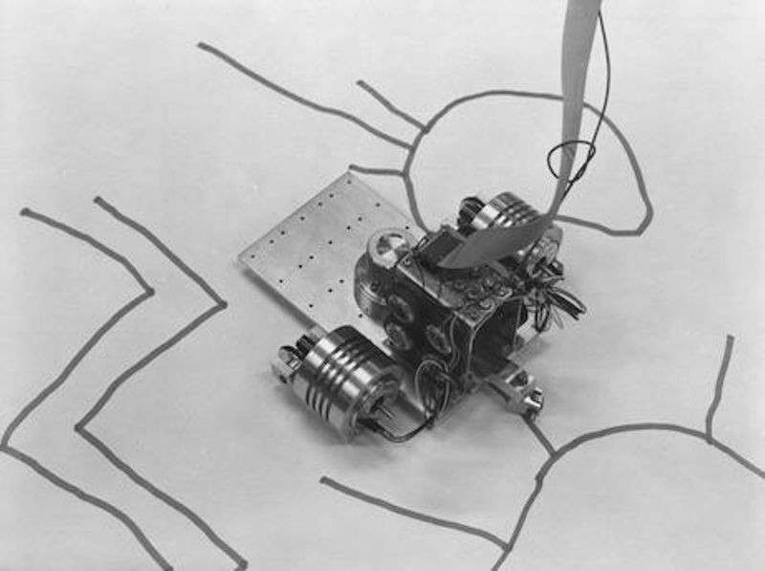
1985

Slide 16
1997

Slide 17
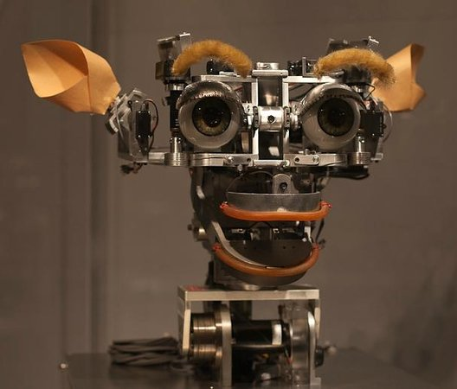
2000

Slide 18
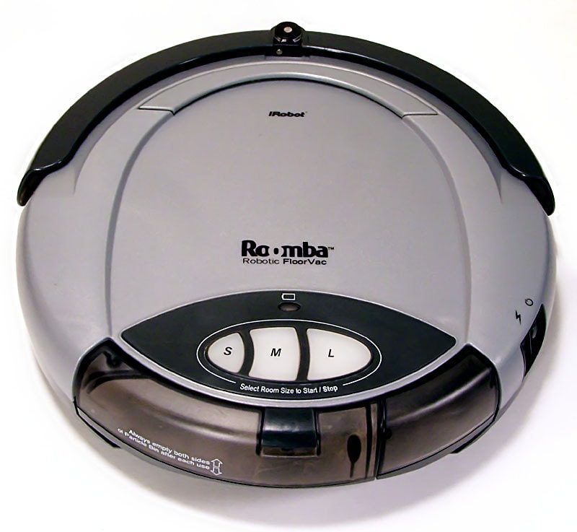
2002

Slide 19
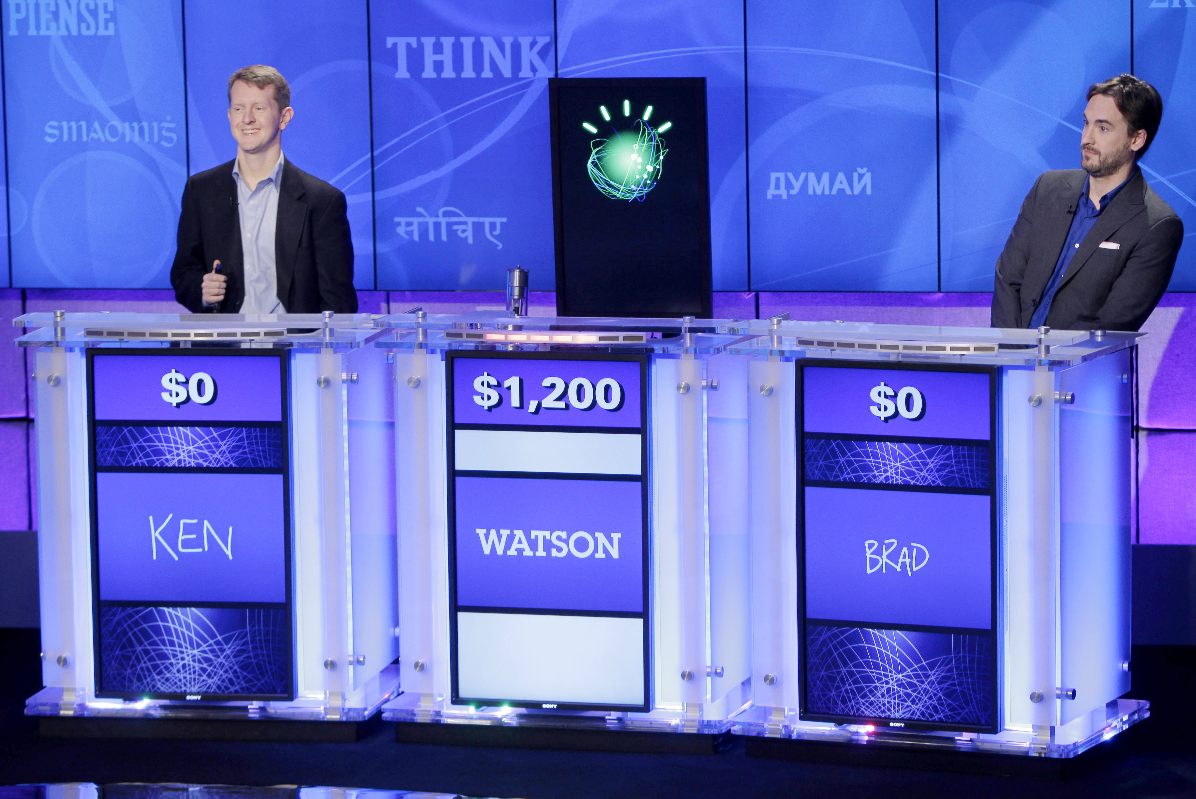
2011

Slide 20
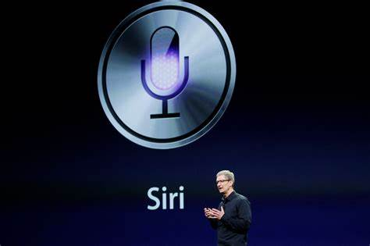
2011

Slide 21
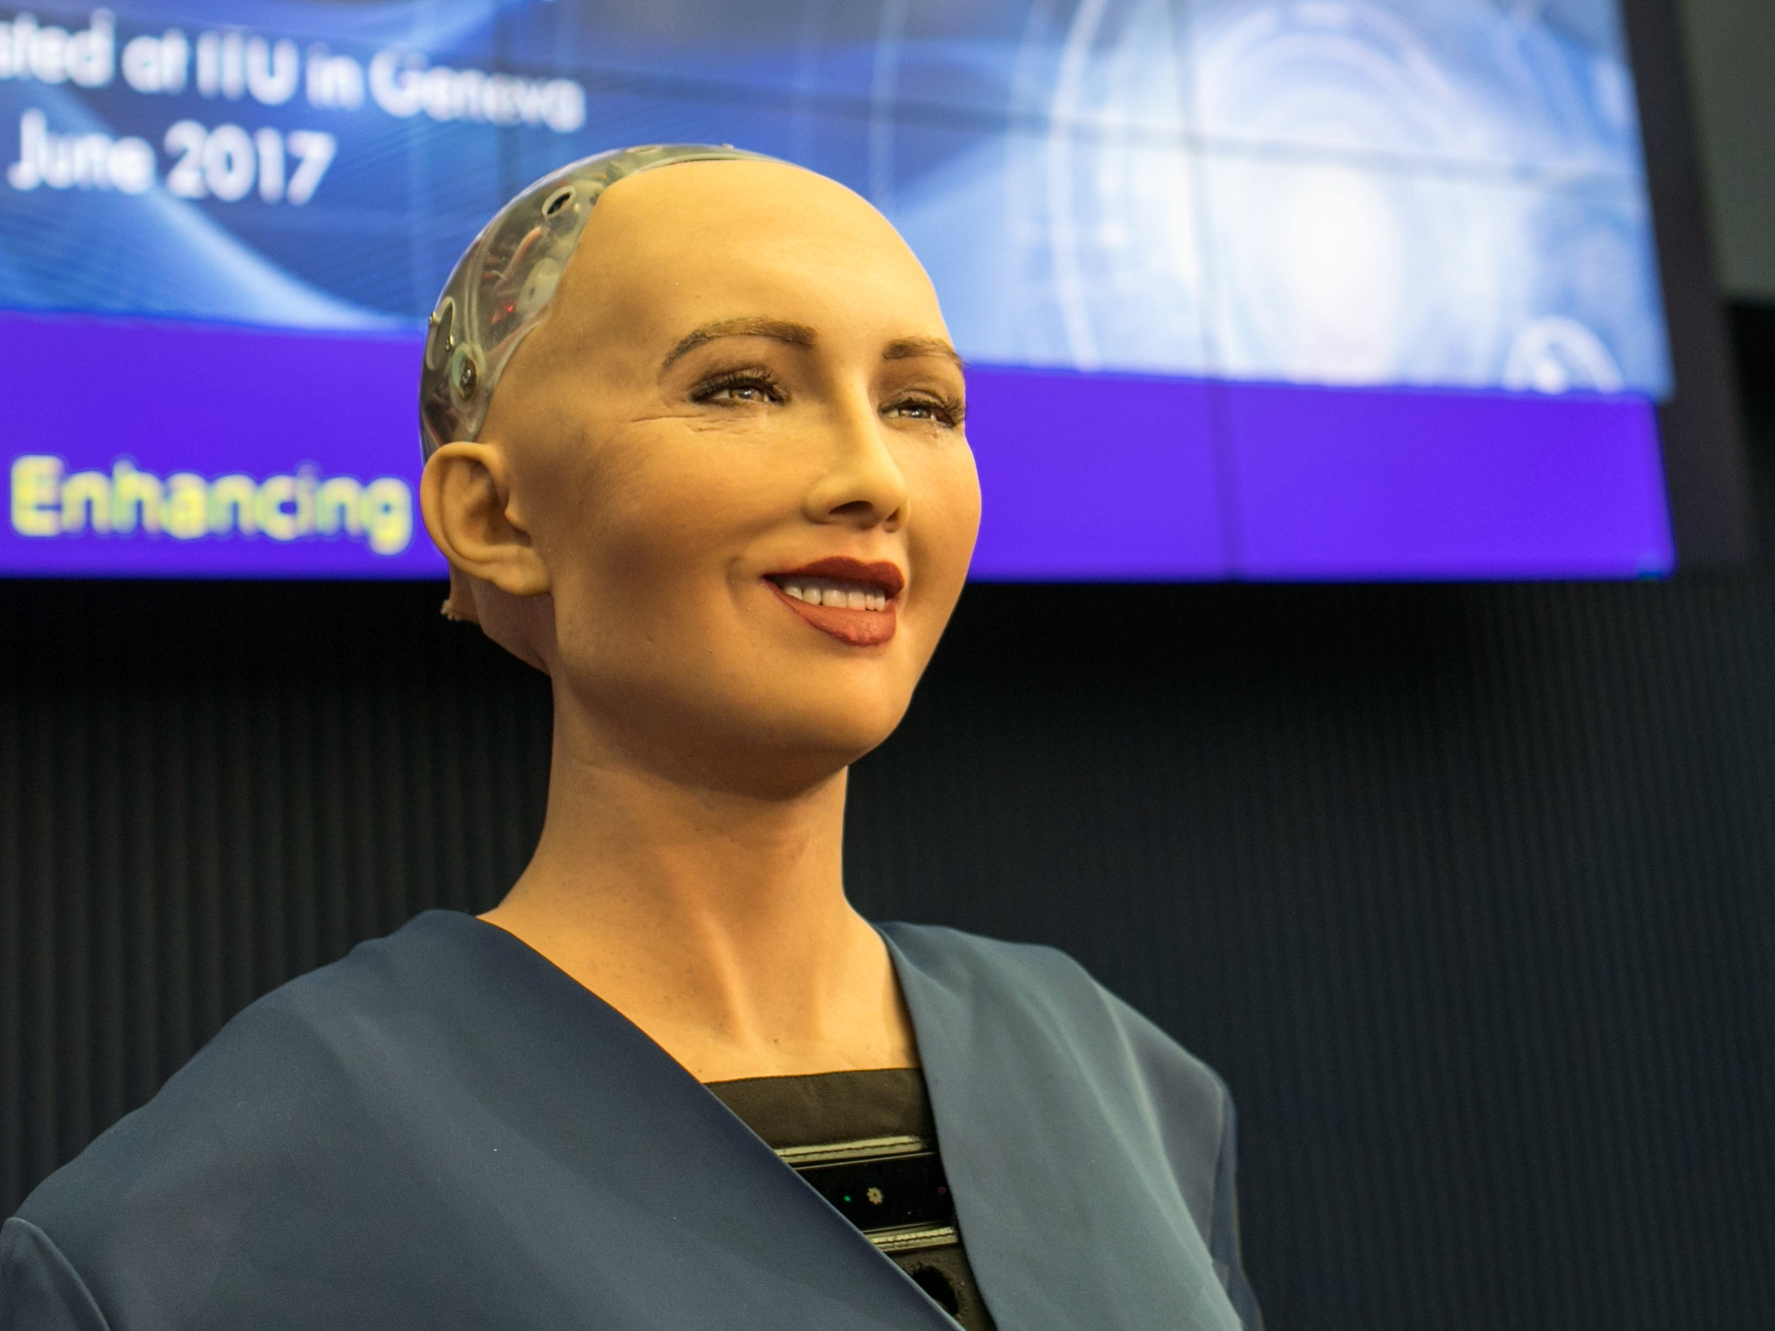
2016

Slide 22
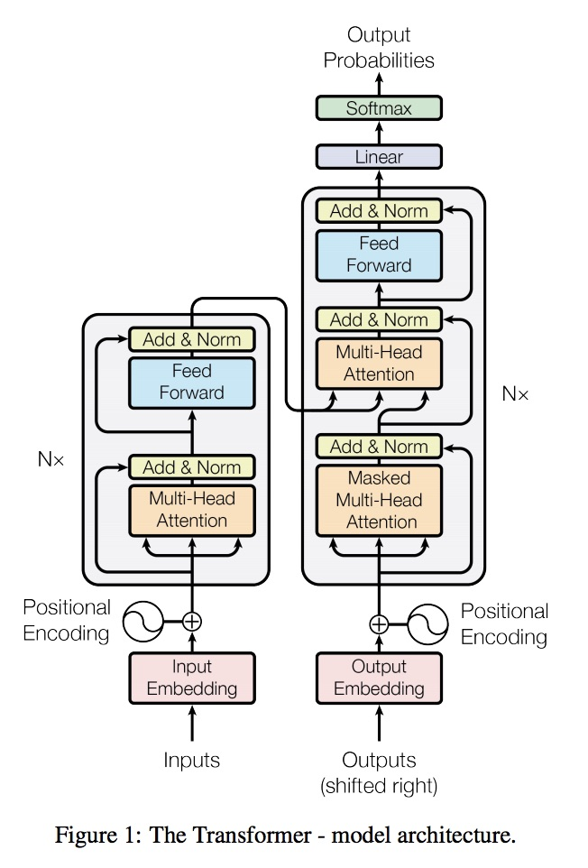
2017

Slide 23
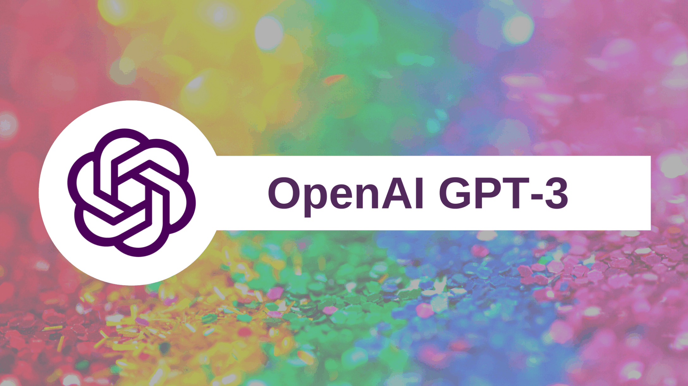
2020

Slide 24
2021

Slide 25

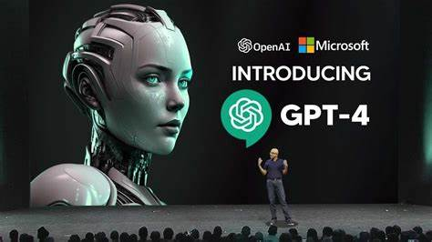

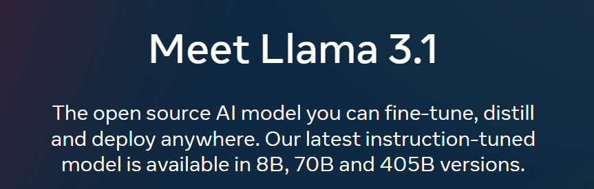
2022-Present

Slide 26

Why did AI Boom?
From the 1960s to about 2012, the amount of computing power used to train top machine learning applications followed Moore’s law.
From 2012 to 2018 there was a 300,000-fold increase, which works out to a doubling every 100 days or so
A machine learning model that took a full day to train in 2014 takes only two minutes in 2018

Slide 27
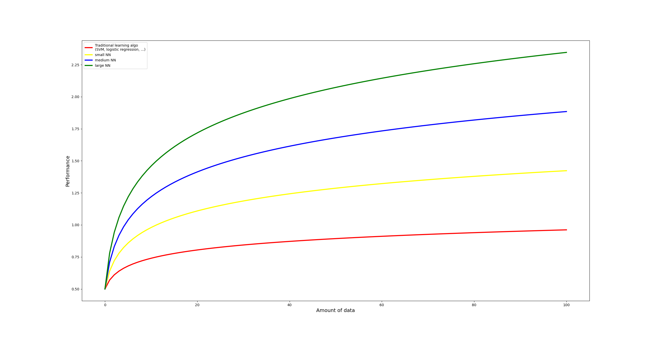
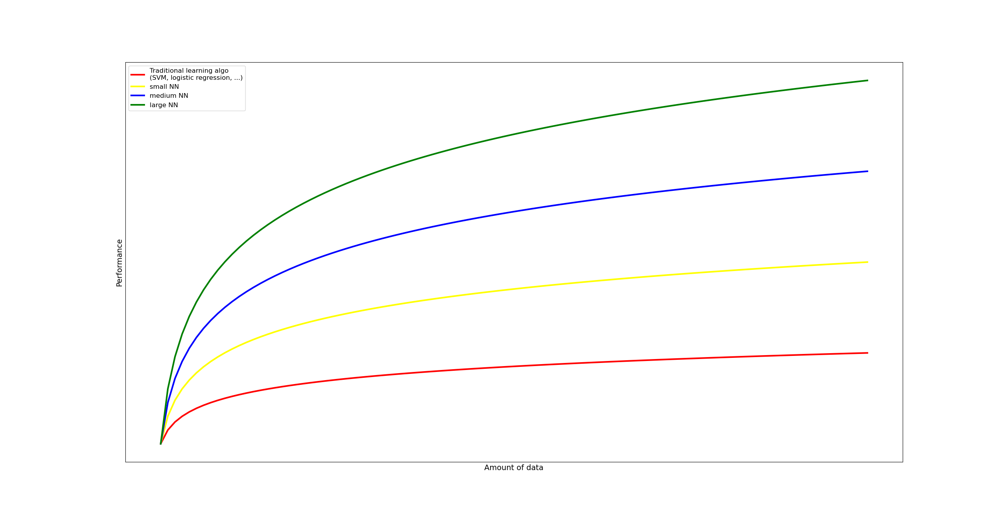
With the recent advancement in internet and sensor technologies, we were able to put our hands on more data. Not only that, but we learned how to use this data

Slide 28
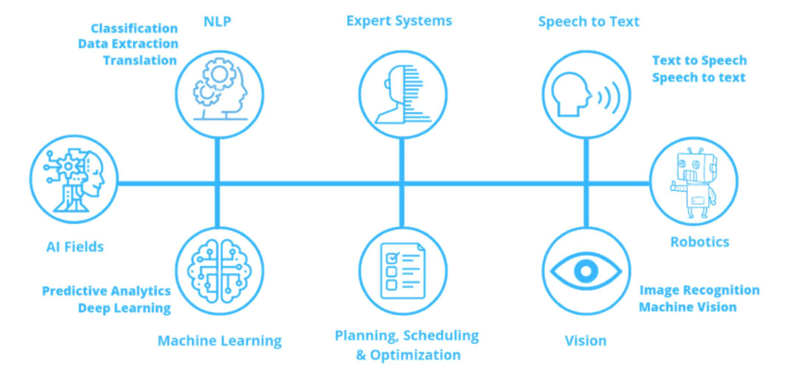
AI Fields

Slide 29
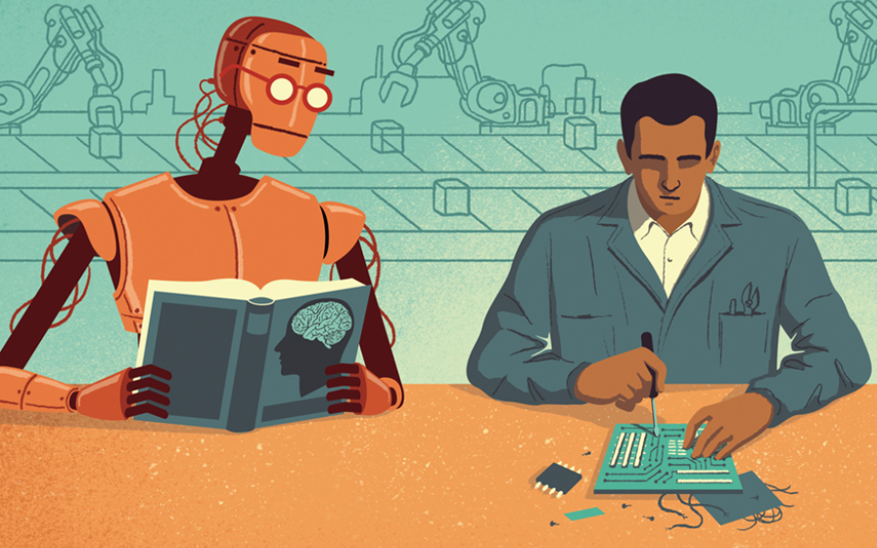
Machine Learning
Machine Learning is the science (and art) of programming computers so they can learn from data. Here is a slightly more general definition:
[Machine Learning is the] field of study that gives computers the ability to learn without being explicitly programmed.
—Arthur Samuel, 1959
And a more engineering-oriented one:
A computer program is said to learn from experience E with respect to some task T and some performance measure P, if its performance on T, as measured by P, improves with experience E.
—Tom Mitchell, 1997

Slide 30
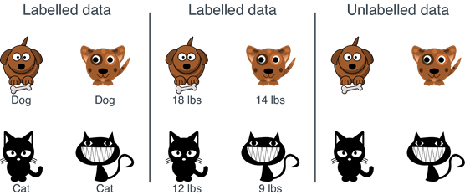
Supervised learning
Supervised learning is a machine learning approach that’s defined by its use of labeled datasets. These datasets are designed to train or “supervise” algorithms into classifying data or predicting outcomes accurately. Using labeled inputs and outputs, the model can measure its accuracy and learn over time.
Unsupervised learning
Unsupervised learning uses machine learning algorithms to analyze and cluster unlabeled data sets. These algorithms discover hidden patterns in data without the need for human intervention (hence, they are “unsupervised”).
Unsupervised learning models are used for three main tasks: clustering, association and dimensionality reduction

Slide 31
Structured vs Unstructured Data
Structured data refers to data that is highly organized and easily searchable in fixed formats, typically within relational databases.
Unstructured data refers to data that does not have a predefined format or structure, making it more difficult to, process and analyze. It’s estimated to be about 80% or more of all the data businesses have.
It's also worth mentioning semi-structured data, which falls between structured and unstructured data. It has some organizational properties but does not conform to a rigid structure.
Examples: JSON, XML, email metadata

Slide 32
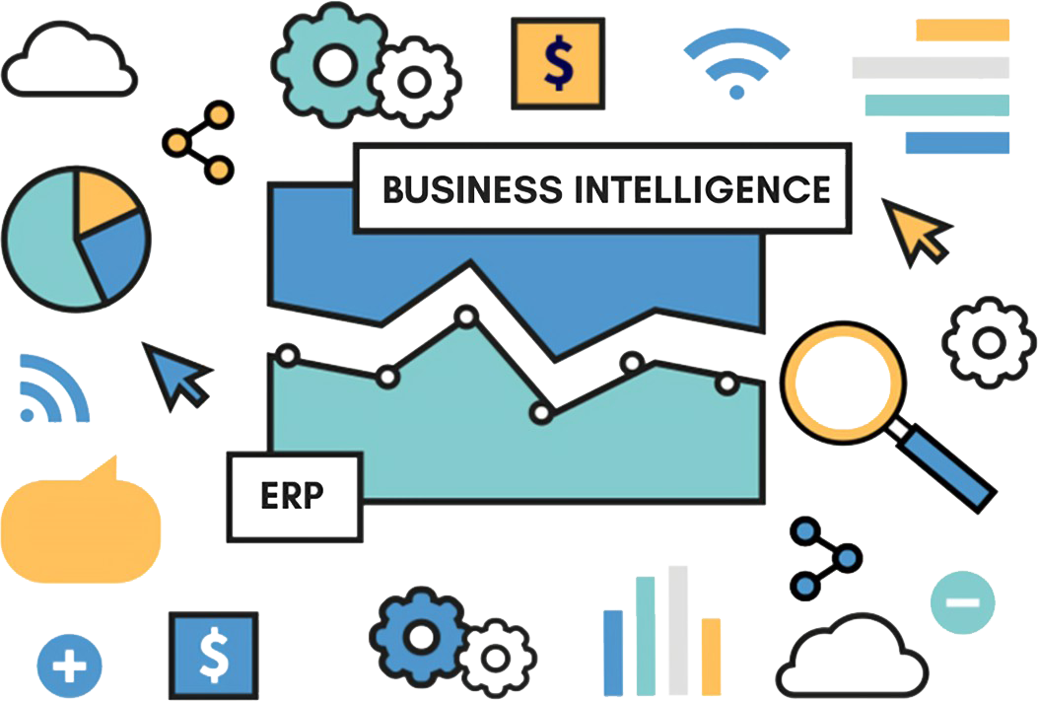
Applications
AI in business intelligence
Some of the ways that AI is being used in BI include:
Data collection: Collecting data from a variety of sources, including structured data (for example, databases) and unstructured data (for example, text documents, images, and videos)
Data analysis: To analyze data and identify patterns, trends, and relationships
Data visualization: AI can help create visualizations that make it easier to understand data
Decision-making: Insights and recommendations generated by AI models can help drive data-driven decision-making for businesses

Slide 33
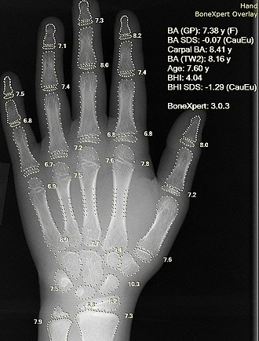
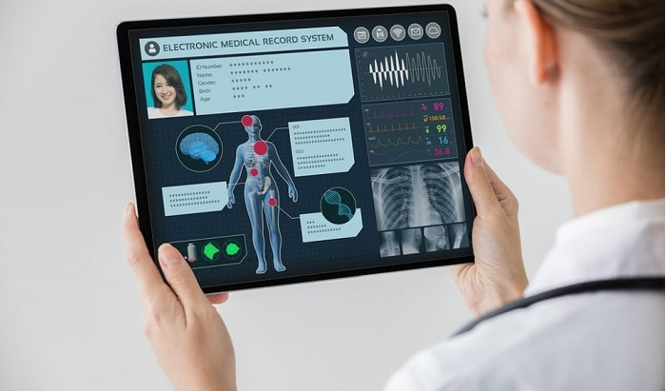
AI in Healthcare
Bone age prediction using X-Ray
Disease diagnosis: AI can be used to analyze patient data and identify patterns that may indicate a disease. This can help doctors diagnose diseases earlier and more accurately.
Treatment development: By analyzing large datasets of patient data, AI can identify new patterns and relationships that can be used to develop new drugs and therapies.
Personalized care: By analyzing a patient's data, AI can help doctors develop treatment plans that are tailored to the patient's specific needs.

Slide 34

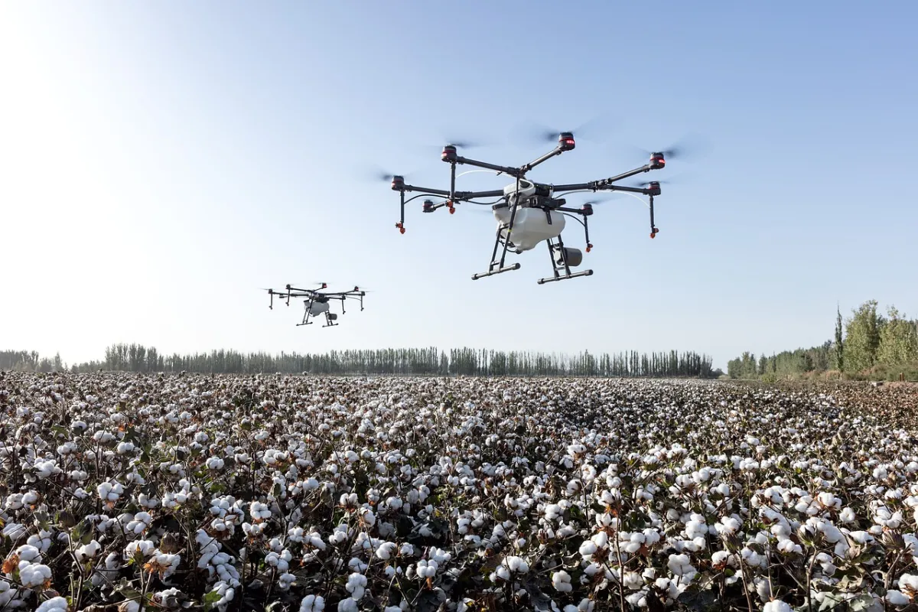
AI in Agriculture
Crop yield improvement: Analyzing data on soil conditions, weather patterns, and crop growth with AI models and tools could help to develop strategies that can improve crop yields
Cost reduction: Automating tasks with AI, such as harvesting and irrigation, which can reduce labor costs
Environmental protection: Monitoring and managing natural resources, such as water and soil

Slide 35
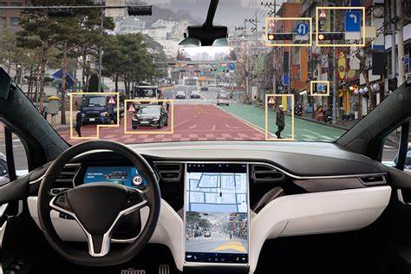
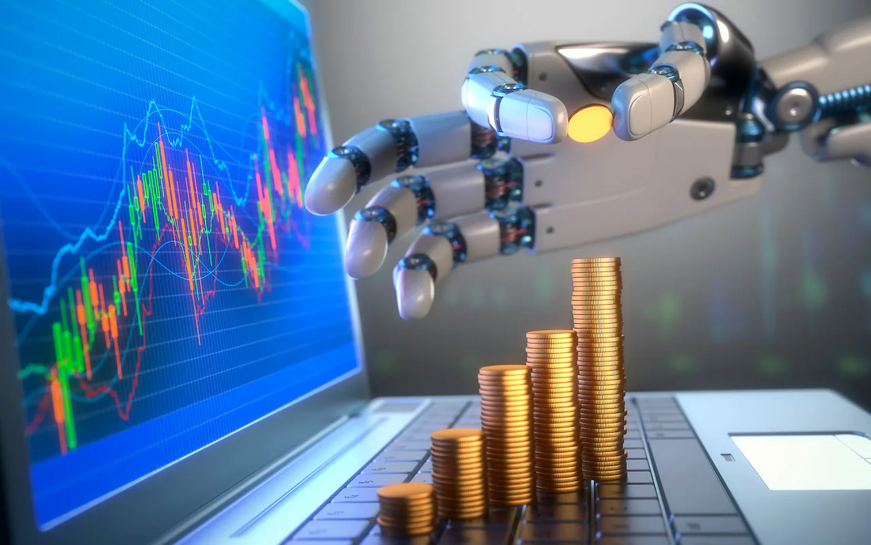
Additional AI applications
In addition to the applications listed above, AI is also being used in a variety of other industries, including:
Finance: AI is being used to detect fraud, manage risk, and make investment decisions
Retail: AI is being used to personalize the shopping experience, recommend products, and manage inventory
Transportation: AI is being used to develop self-driving cars and improve traffic management
Energy: AI is being used to improve energy efficiency and predict energy demand
Government: AI is being used to improve public safety, detect crime, and provide citizen services
Manufacturing: AI is being used for improved efficiency, increased productivity, improved quality

Slide 36

Why do we use Python?
Ease of Learning and Use: Python is the most suitable programming language for this because it is easy to understand and you can read it for yourself.
Rich Ecosystem of Libraries: Python has a vast collection of libraries and frameworks specifically designed for AI and machine learning tasks.
Compatibility and Interoperability: Python can easily interface with other programming languages and technologies, making it suitable for integrating AI into diverse environments and systems.
Platform Independence: meaning that code written in Python can run on various operating systems without modification

